Slide 1
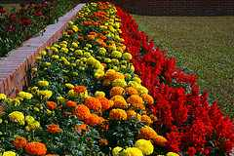
Well Come

Slide 2
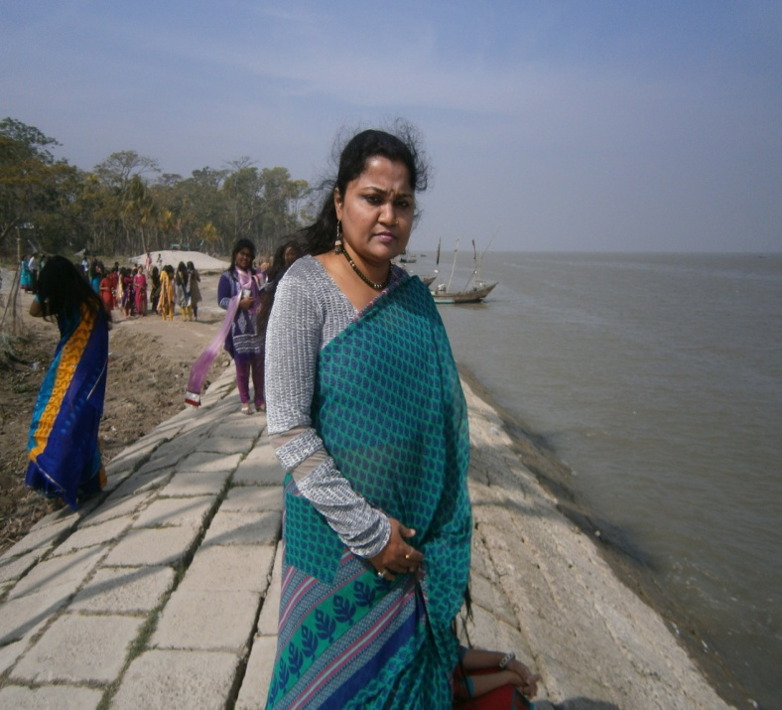
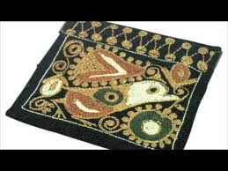
NSARMIN JAHAN.
ASSISTANT TEACHER,
BHOLA GOVT. GIRLS’ HIGH
SCHOOL.BHOLA.

Slide 3
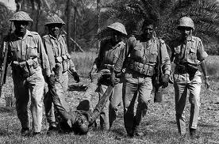
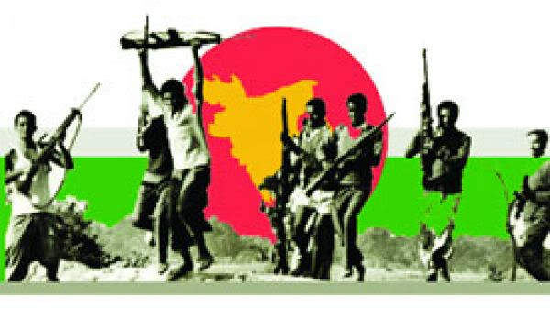
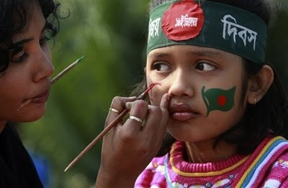
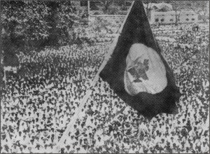

Slide 4
WHAT ARE THESE PICTURE ABOUT ?

Slide 5
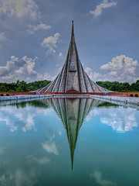
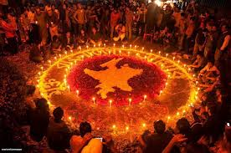
OUR PRIDE
CLASS:SIX
Subj. :English 1st Paper
Unit:14,Lesson:1

Slide 6
  After complete the lesson….
Student will learn about our independence and answer short question about it.⇨⇨⇨
They will learn new vocabularies from it.
They can write about our pride and our independence Day .

Slide 7
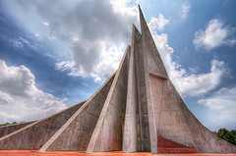
WE PAY OUR DEEP RESPECT TO THE MARTYRS WHO LAID DOWN HERE.

Slide 8
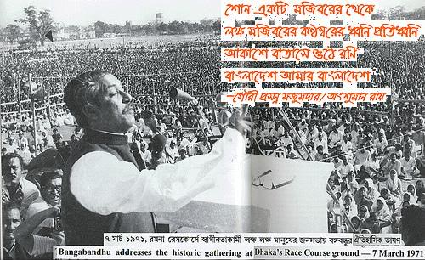
In 1971 Bangabandhu Sheik Mujibur Rahman
declared the independence of Banladesh.
For this 25th march1971 the Pakistani army swooped down upon and killed many unarmed people of Bangladesh.

Slide 9

In 25th march Pakistni Armies killed unarmed Bangladeshi peoples.
26th march 1971 announced the independence day of Bangladesh.
After a bloody war of nine months Bangladesh came out victories on 16th December 1971.
We celebrate the day every year with joy and sorrow.

Slide 10
GROUP WORK
WHY DO THINK 25TH MARCH IS A RED LETTER DAY?

Slide 11
Evaluation
Which is independence day?
What is 25th march?
Which day is our victory day?
Make sentence with these words………Independence, surrendered, Victory.

Slide 12
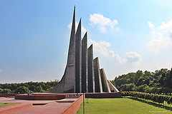
HOME WORK
WRITE 10 SENTENCE ABOUT OUR INDEPENCE.

Slide 13
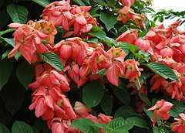
HTANK YOU

